Slide 1


Architecture, Real-World Problems, and Practical Solutions
eBPF
DevFest Armenia 2025
Massoud Asadi

Slide 2
Agenda
The problem with traditional networking & observability
What eBPF is and why it exists
How eBPF works internally
Live demo overview
Google use cases
How to use eBPF in your own projects
Key takeaways & Q&A

Slide 3
The problem with traditional networking & observability
The Kernel Bottleneck: traditionally, if you wanted to add a new feature to the Linux kernel (like a new security monitor), you had two choices:
Upstream a change: This takes years of discussion and testing.
Kernel Modules: Dangerous. A single bug in a module crashes the entire system (Kernel Panic).
The Observability Tax: old tools like tcpdump or standard logging often require copying data from the Kernel to User Space. This "Context Switching" is computationally expensive and slow.

Slide 4
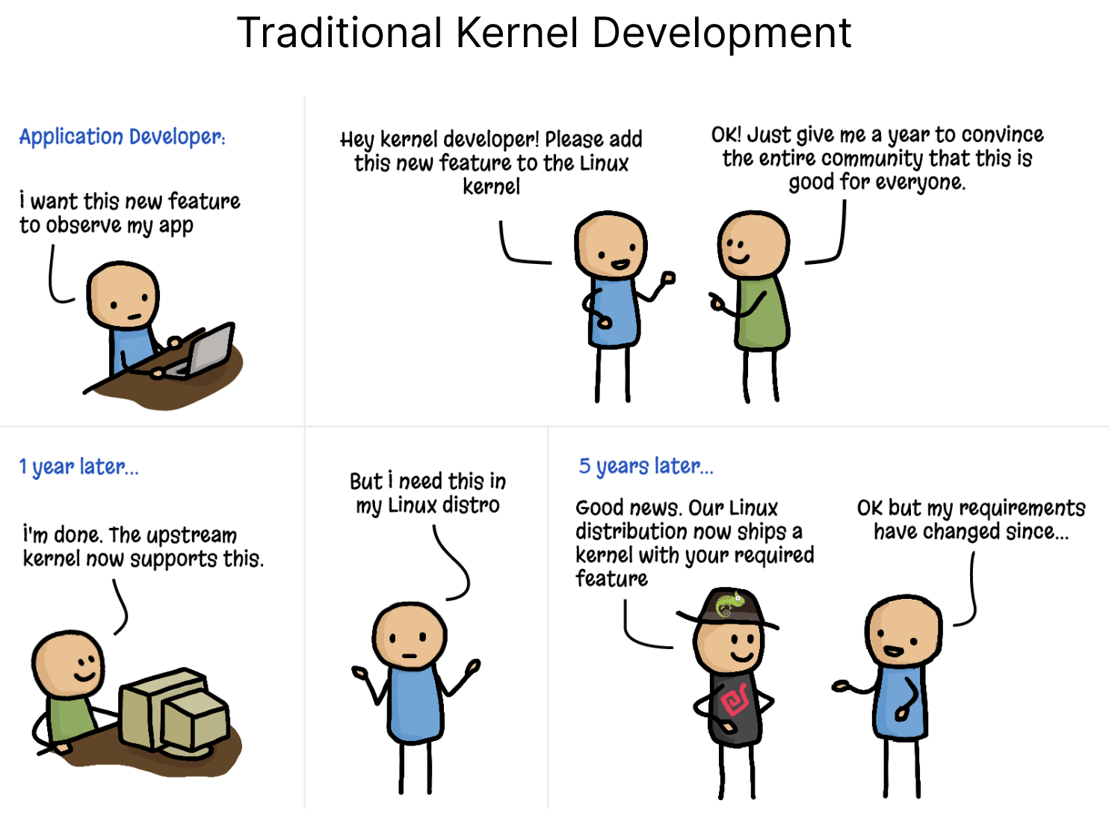

Slide 5
What eBPF is and why it exists
Think of this as the "Sandboxed Virtual Machine" inside the Linux Kernel.
The Analogy: If the Linux Kernel is the operating system of a smartphone, eBPF is the App Store. It allows you to download and run small 'apps' (eBPF programs) that add new features to the system instantly, without having to wait for a software update or reboot the phone.
The Power: It allows you to execute custom code at extremely high speeds because the code runs inside the kernel, right where the events (packets, system calls) are happening.

Slide 6
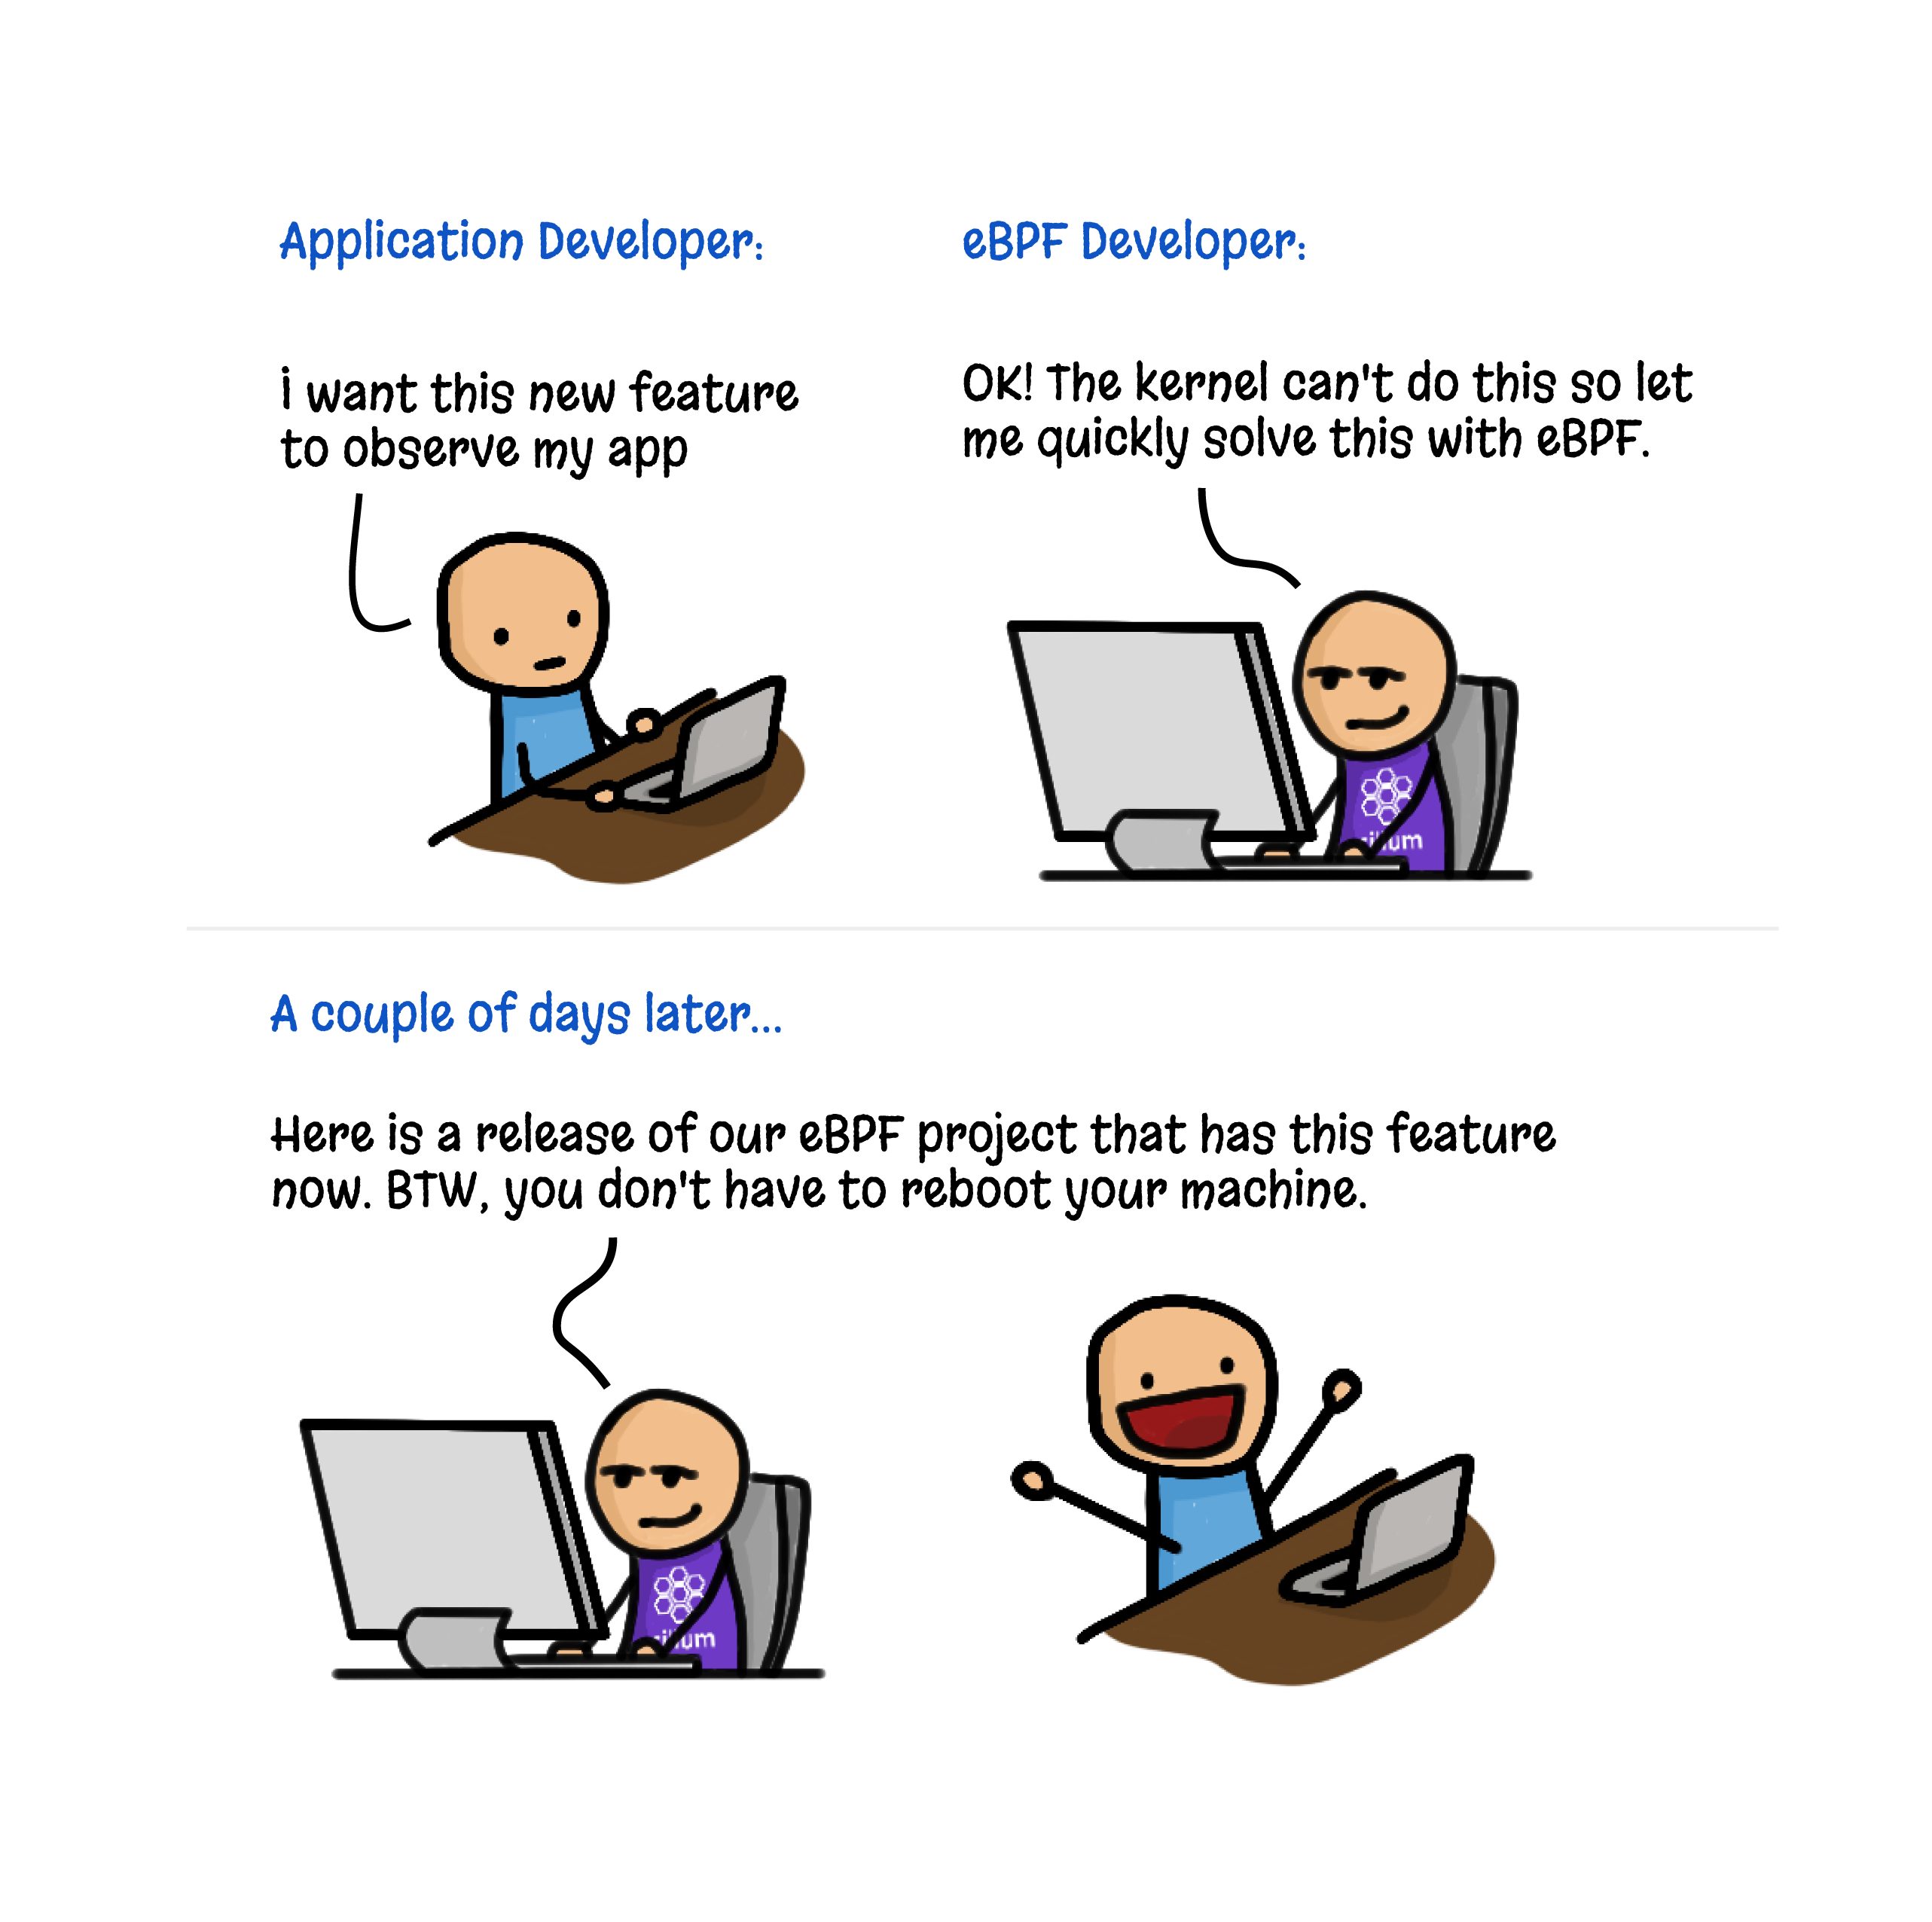

Slide 7
How eBPF works internally
Hooks: eBPF programs are event-driven. They "hook" into events like:
System Calls: A file being opened.
Network Events: A packet arriving at the network card (XDP).
Function Calls: A specific line of code executing in the kernel (kprobes).
The Verifier: Before a program runs, the kernel "reads" it to ensure it is safe. It checks for:
No infinite loops (the program must terminate).
No accessing restricted memory.
Proper permissions.

Slide 8
How eBPF works internally
The JIT Compiler: Once verified, the bytecode is turned into native machine code so it runs at 100% hardware speed.
Maps: Since the program lives in the kernel, it needs a way to send data back to your dashboard. eBPF Maps are key-value stores used to share data between the kernel and user space.

Slide 9
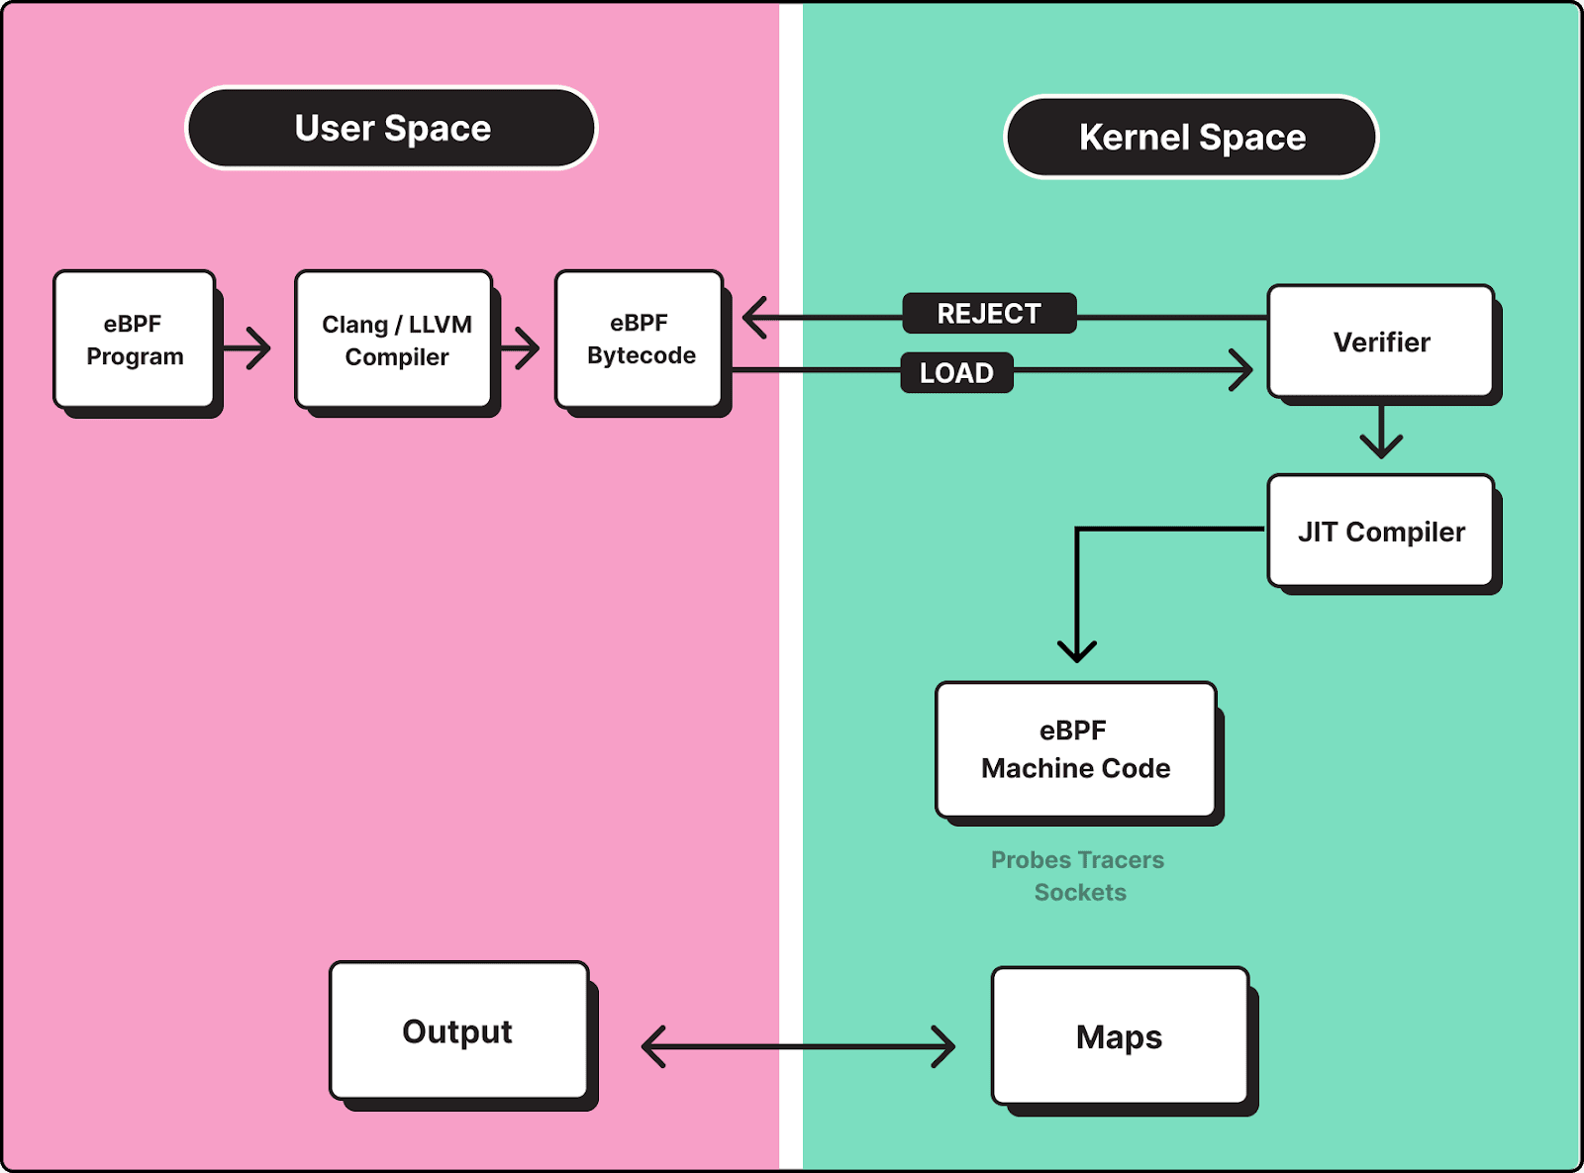

Slide 10

Live demo overview
Network Firewall program: drop packets from specific IP.
Process Monitor program: monitor specific process.
Link to slides and codes:
https://github.com/massoudasadi/DevFestArmenia2025

Slide 11
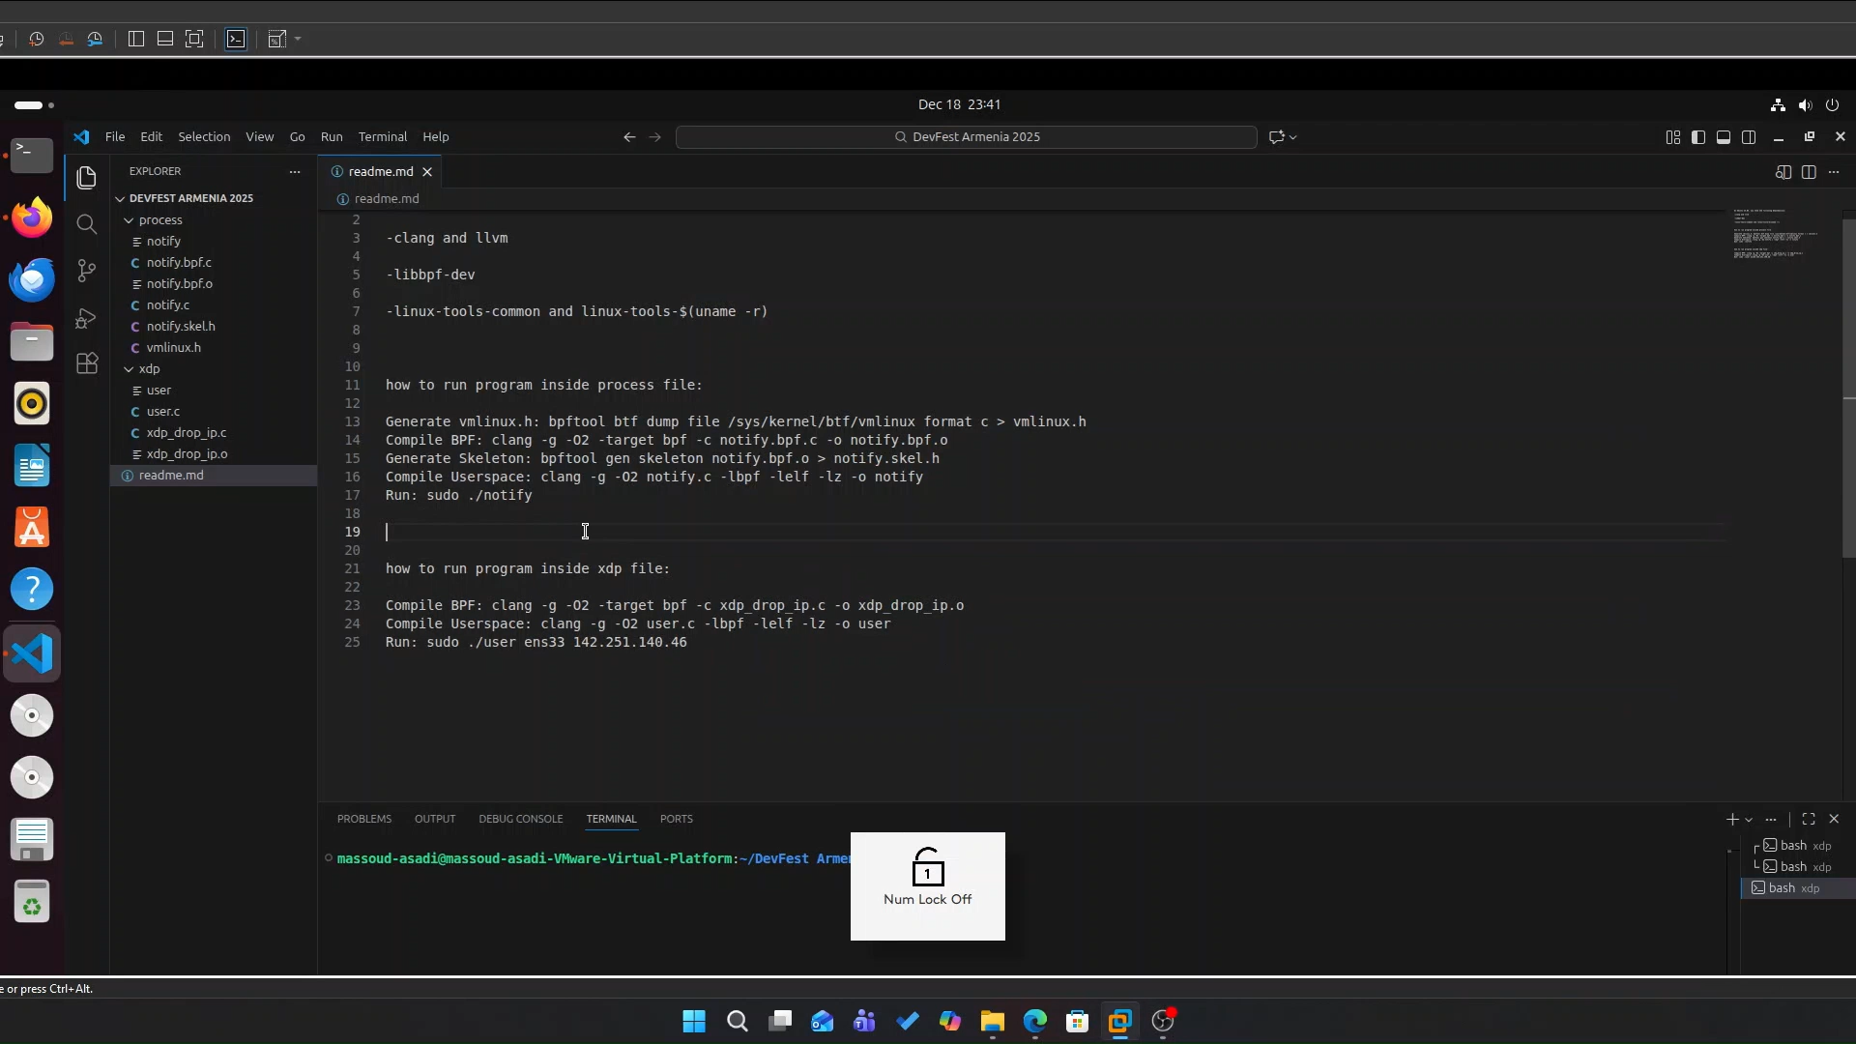
Demo

Slide 12
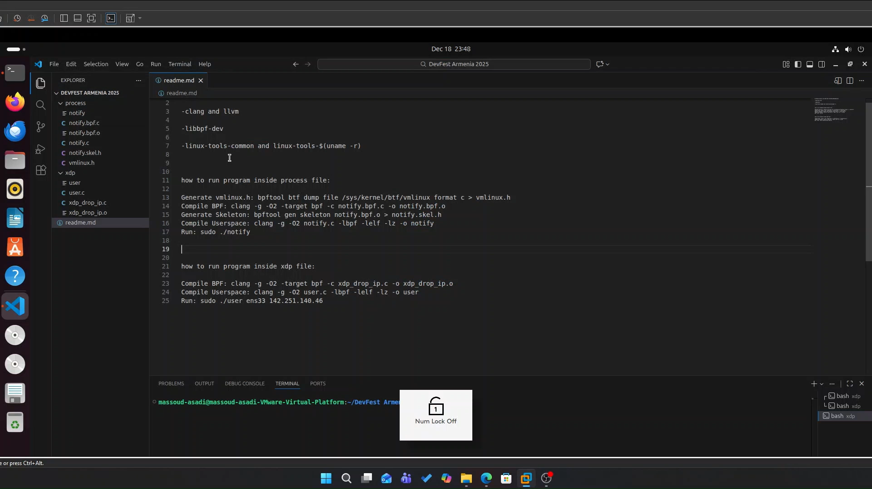
Demo

Slide 13
Google use cases
GKE (Google Kubernetes Engine): Uses eBPF to replace iptables. This makes networking for thousands of containers much faster and more secure.
gVisor: Google’s container runtime uses eBPF to intercept system calls and ensure a container isn't trying to "escape" into the host system.
Android: eBPF is used in Android to monitor per-app data usage and manage battery life by tracking which apps are waking up the CPU.

Slide 14
How to use eBPF in your own projects
If you are a Python developer, use BCC. BCC allows you to embed your kernel code as a string inside a Python script. It handles the heavy lifting—the compilation and the loading—automatically. It is the fastest way to build a custom monitoring agent or a security scanner.
If you are a Rust developer, look at Aya. This is a game-changer. Historically, the 'kernel side' was always C. Aya is the first native-Rust library that allows you to write the kernel program and the user-space app entirely in Rust. This means you get Rust's memory safety guarantees and its powerful tooling (Cargo) for the entire project. It even lets you share code between your app and the kernel.
If you are in the Go ecosystem, the Cilium/eBPF library is the industry standard. It’s what powers some of the largest Kubernetes networking projects in the world.

Slide 15
Key takeaways
Speed: No more context-switching overhead.
Safety: The Verifier makes it impossible to crash the kernel.
Visibility: You can see everything happening in the system with zero "blind spots."

Slide 16
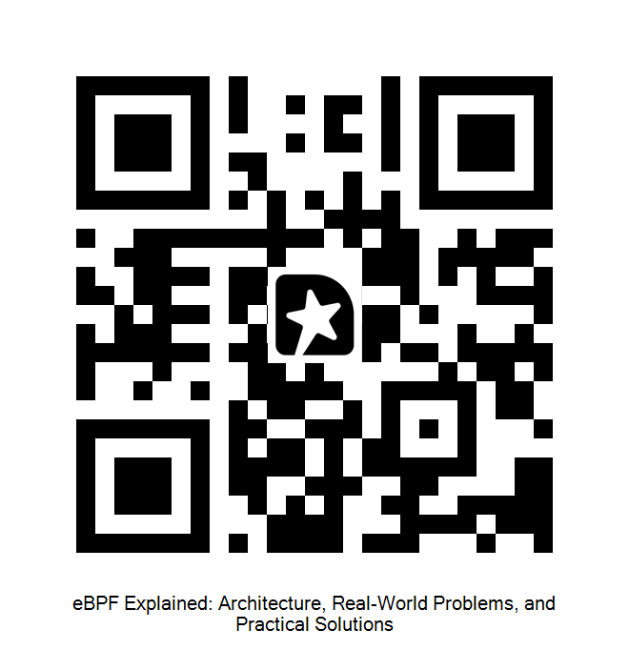
Q&A
Thank You
Massoud.asadi@hotmail.com
DevFest Armenia 2025
Massoud Asadi

